Slide 1

Alien Invasion Project
Hitaxi Gohil

Slide 2
Project Overview & Goal
The Objective: Transform a standard class project into a high-energy arcade experience
The Approach: Adding “Game Juice”: feedback that makes gameplay feel satisfying

Slide 3
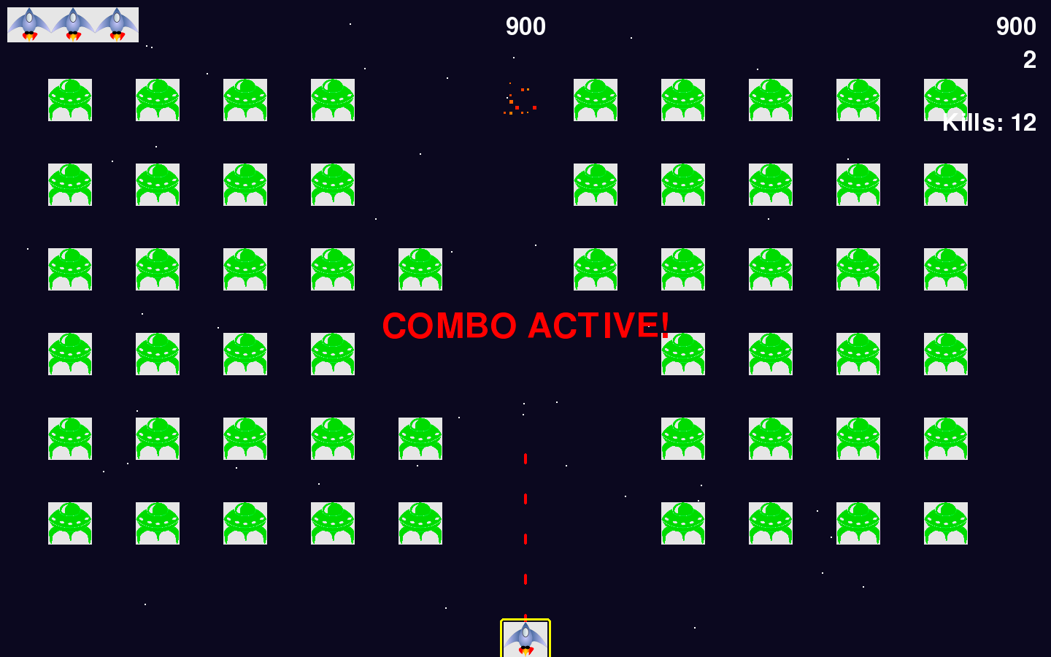
The Combo System (Player Reward)
Rewards accuracy and rhythm
10-kill streak → 2-second Auto-Fire Combo
Bullets change from gold → vibrant red
“COMBO ACTIVE!” notification appears

Slide 4
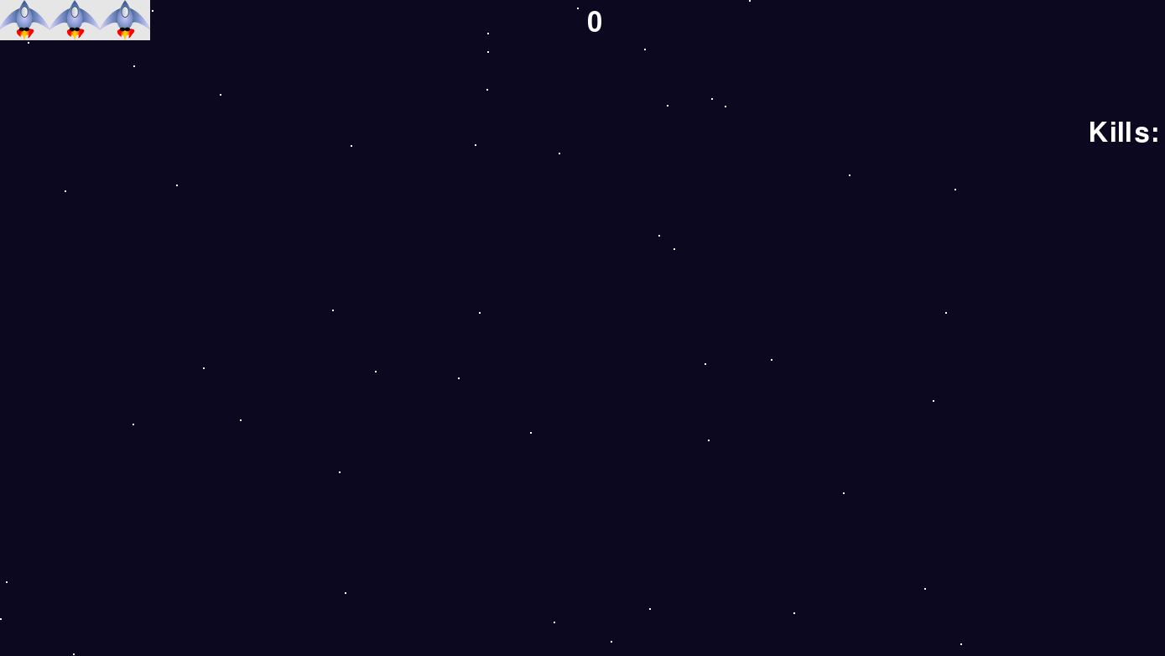
Visual Polish – The Starfield
Randomized scrolling starfield
50 stars moving continuously
Wrap-around effect (bottom → top)
Adds depth and motion

Slide 5
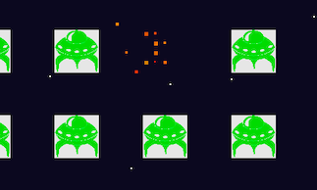
Impact Feedback – Particle Explosions
Aliens don’t just disappear
Each hit creates a particle explosion
15 particles move randomly and fade out
Adds weight and satisfaction

Slide 6
UI & Technical Growth
Persistent Kill Counter for clear progress
Modular code structure (separate files)
Cleaner, scalable, and maintainable design
Transforms a simple project into a polished game

